Slide 1



DEPARTMENT OF ELECTRICAL AND ELECTRONICS ENGINEERING
EEB1204 - ELECTRON DEVICES AND CIRCUITS
FINAL REVIEW
Temperature based fan speed control and monitoring
YEAR/ SEMESTER – II/III
BATCH NUMBER :
DATE :28-08-2024
PRESENTED BY:
DHARSAN S (927623BEE023)
DINESHKUMAR M (927623BEE025)
DINESH S (927623BEE026)
ELAMURUGAN M (927623BEE028)
HARIVASANTH A (927623BEE032)
GUIDED BY:
Dr.S.Banumathi, M.E., Ph.D,
Professor /EEE

Slide 2
ABSTRACT
This project presents the design and implementation of a temperature-based fan speed control and monitoring system using an Arduino microcontroller, a 16x2 LCD display, an LM35 temperature sensor, and a voltage regulator. The primary objective is to automatically control the fan speed based on temperature readings from the LM35 sensor. As the temperature changes, the system adjusts the fan's speed proportionally, providing an efficient and energy-saving approach to temperature control. The system also displays real-time temperature and fan speed status on the LCD, making it ideal for applications in industrial and domestic environments where controlled cooling is necessary

Slide 3
LITERATURE REVIEW
VishnuPriya,R.,&Nirmala,M."Automatic Temperature-Based Fan Speed Controller Using Arduino."(2024)
This paper focuses on designing an automatic temperature-based fan speed controller using Arduino. It explores how temperature variations detected by an LM35 sensor can drive a fan's speed via PWM control for efficient cooling. It emphasizes energy savings and automation. 2.Venkatesh, R., & Kumar, S"Temperature-Controlled Fan Using Arduino for Energy Efficiency." (2023):
This paper focuses on developing a temperature-controlled fan system using Arduino to enhance energy efficiency. It integrates the LM35 temperature sensor and PWM technique to dynamically adjust the fan speed based on environmental temperature changes. This study highlights energy savings achieved through precise control mechanisms and discusses its applications in domestic and industrial cooling systems.

Slide 4
IDENTIFICATION & DEFINITION OF PROBLEM
Many environments, controlling the fan speed manually is inefficient and can lead to discomfort or energy wastage. As the temperature fluctuates throughout the day, manual adjustments to fan speed are inconvenient. An automated system is required to maintain a comfortable environment by adjusting the fan speed based on temperature changes. Additionally, monitoring the current temperature and fan speed is essential in some industrial or home automation applications to ensure optimal conditions.
Problem Statement:
Manual fan speed control in response to temperature variations is inefficient and inconvenient. There is a need for an automated system that controls fan speed based on temperature and allows real-time monitoring.

Slide 5
IDENTIFICATION OF ALTERNATE SOLUTIONS
1. Manual Fan Speed Controllers:
- Inexpensive and easy to implement.
- Requires constant human intervention for adjustment.
2. Thermostat-Based Control:
- Can be set to activate fans at specific temperature thresholds.
- Lacks fine-tuned control over the speed, usually only on/off.
3. Microcontroller-Based Systems with Relays:
- Fans can be turned on or off based on temperature.
- More control is needed for adjusting speed at different temperature levels.
4. Arduino with PWM-Based Speed Control :
- Provides fine-grained control over fan speed using PWM.
- Monitors both temperature and speed in real time.
- Allows for easy customization and scaling.

Slide 6
PROJECT OBJECTIVES
Design and implement an automated fan speed control system that adjusts speed according to temperature readings.
Display real-time temperature and fan speed on a 16x2 LCD to provide users with monitoring capabilities.
Ensure energy efficiency by allowing the fan to operate only as necessary, based on temperature variations.
Develop a cost-effective solution suitable for domestic and industrial applications with minimal maintenance requirements.

Slide 7
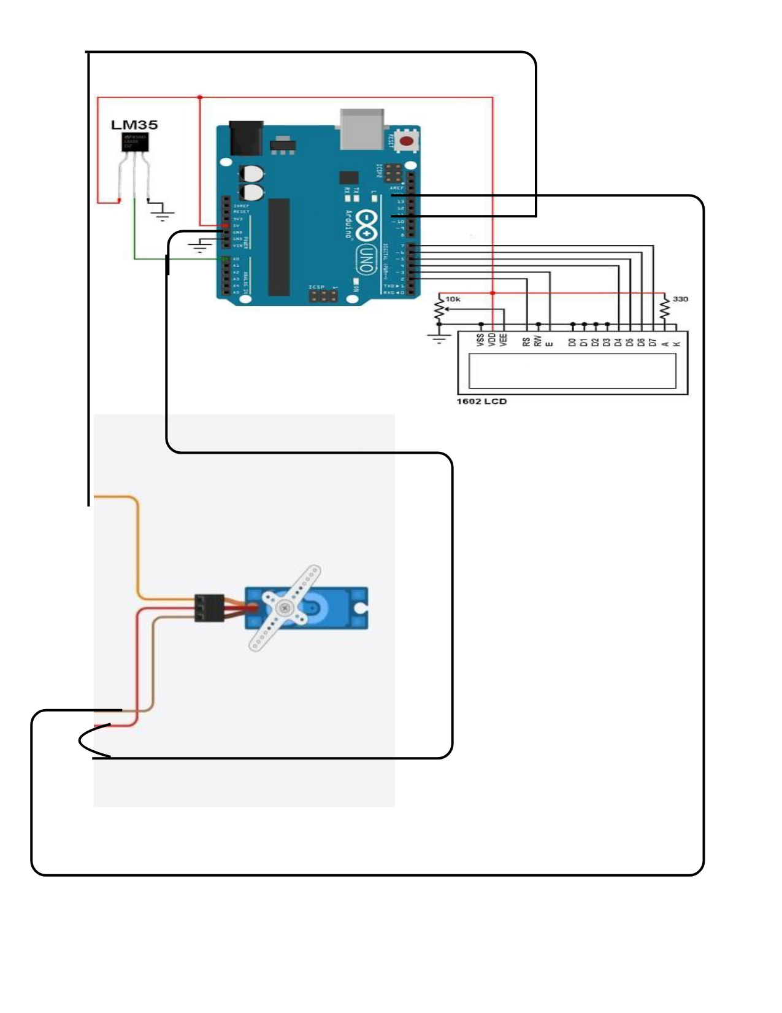
CIRCUIT DIAGRAM

Slide 8
COMPONENTS USED
Arduino Uno Board
16*2 LCD Display
LM35 Temperature Sensor
SG90 Servo Motor

Slide 9
COMPONENTS DESCRIPTION
Arduino Uno:
Acts as the brain of the system, processing data from the temperature sensor (LM35) and controlling the speed of the fan based on the temperature readings. The Arduino is programmed using C++ to receive input from the LM35 sensor and send output to the transistor controlling the fan
.LM35 Temperature Sensor:
A precision temperature sensor that provides an analog output proportional to the temperature. The sensor outputs a voltage that is directly proportional to the centigrade temperature (10mV per degree Celsius). The LM35 is connected to one of the analog pins of the Arduino for continuous temperature monitoring.

Slide 10
COMPONENTS DESCRIPTION
Servo Motor:
The SG90 is a small-sized servo motor with a 180-degree range of motion, typically controlled by pulse-width modulation (PWM). It’s widely used for applications that require precise control over movement within a limited range, making it ideal for controlling small mechanisms
16x2 LCD Display:
A standard display module to show temperature readings and fan speed information to the user in real-time.

Slide 11
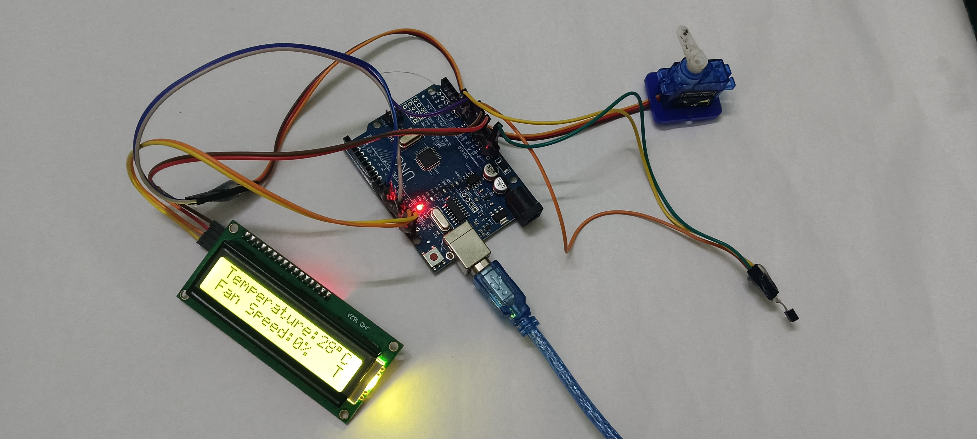
HARDWARE PHOTO

Slide 12
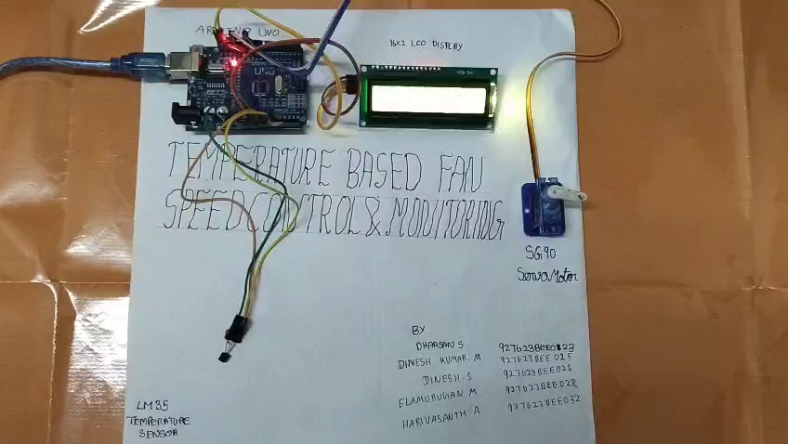
WORKING

Slide 13
ARDUINO SOURCE CODE
#include <LiquidCrystal.h>
LiquidCrystal lcd(7,6,5,4,3,2);
int tempPin = A1;
int fan = 11;
int led = 8;
int temp;
int tempMin = 30;
int tempMax = 60;
int fanSpeed;
int fanLCD;

Slide 14
ARDUINO SOURCE CODE
void setup() {
pinMode(fan, OUTPUT);
pinMode(led, OUTPUT);
pinMode(tempPin, INPUT);
lcd.begin(16,2);
Serial.begin(9600);
}
void loop()
{
temp = readTemp();

Slide 15
ARDUINO SOURCE CODE
if(temp < tempMin)
{
fanSpeed = 0;
analogWrite(fan, fanSpeed);
fanLCD=0;
digitalWrite(fan, LOW);
}
if((temp >= tempMin) && (temp <= tempMax))
{
fanSpeed = temp;

Slide 16
ARDUINO SOURCE CODE
fanSpeed=1.5*fanSpeed;
fanLCD = map(temp, tempMin, tempMax, 0, 100);
analogWrite(fan, fanSpeed);
}
if(temp > tempMax)
{
digitalWrite(led, HIGH);
}
else
{
digitalWrite(led, LOW);
}
lcd.print("TEMP: ");

Slide 17
ARDUINO SOURCE CODE
lcd.print("TEMP: ");
lcd.print(temp);
lcd.print("C ");
lcd.setCursor(0,1);
lcd.print("FANS: ");
lcd.print(fanLCD);
lcd.print("%");
delay(200);
lcd.clear(); }
int readTemp() {
temp = analogRead(tempPin);
return temp * 0.48828125;
}

Slide 18
CONCLUSION
The Temperature-Based Fan Speed Control and Monitoring System successfully demonstrates a cost-effective, energy-efficient, and automated method of controlling fan speed based on temperature changes. By integrating an Arduino microcontroller, an LM35 temperature sensor, and a 16x2 LCD, the system provides precise control and real-time monitoring, ensuring optimal performance in both domestic and industrial applications. This project highlights the advantages of using a microcontroller-based approach for automation, including accuracy, adaptability, and user convenience. The inclusion of an SG90 servo motor further adds to the system's flexibility, enabling dynamic airflow direction adjustments. This project effectively reduces manual intervention, conserves energy, and improves thermal comfort.

Slide 19
FUTURE ENHANCEMENT
1. Integration with IoT Platforms:
Add Wi-Fi or Bluetooth modules (e.g., ESP8266 or HC-05) to allow remote monitoring and control of the fan system through mobile apps or web interfaces.
Enable data logging and analytics for better understanding of temperature trends and system performance.
2. Adaptive Cooling System:
Incorporate machine learning algorithms to predict temperature changes and preemptively adjust fan speed for enhanced efficiency.
Implement multiple fan controls for larger spaces, dynamically adjusting speeds based on specific zone temperatures.

Slide 20
FUTURE ENHANCEMENT
3. Addition of Humidity Control:
Integrate humidity sensors to manage both temperature and humidity for a more comprehensive climate control solution.
4. Energy Harvesting:
Use solar panels or other renewable energy sources to power the system, making it more sustainable and reducing energy costs.
5. Enhanced Display and User Interface:
Upgrade the 16x2 LCD to a touchscreen or color display for an improved user interface and additional functionality like setting temperature thresholds.

Slide 21
REFERENCE
Vishnu Priya, R., & Nirmala, M. (2024). "Automatic Temperature-Based Fan Speed
Controller Using Arduino." IARJSET. DOI: 10.17148/IARJSET.2024.1151 .
Venkatesh, R., & Kumar, S. (2023). "Temperature-Controlled Fan Using Arduino for
Energy Efficiency." Published in the International Journal of Innovative Research in
Science and Technology, Volume 12, Issue 6.
Priya, S., & Maheshwari, K. (2019). "Integration of DHT11 Sensor with Arduino for
Smart Cooling Systems." Published in IJIRT, Volume 5, Issue 10. This study
highlights the use of temperature sensors for dynamic fan speed adjustment.

Slide 22
REFERENCE
Sharma, A., & Verma, T. (2024). "IoT-Based Home Automation with Arduino and
Fan Speed Control." Published in International Advanced Research Journal in
Science, Engineering and Technology (IARJSET), Volume 11, Issue 5. The work
explores IoT implementations for cooling systems.
Das, M., & Gupta, R. (2021). "A Low-Cost Prototype for Temperature-Based Fan
Speed Control Using Arduino Nano." Featured in International Journal of Modern
Electronics and Communication Engineering, Volume 9, Issue 4.
.Khan, F., & Ali, Z. (2022). "Efficient Fan Speed Control System Based on Real-
Time Monitoring Using LM35 Sensor." Published in JETIR, Volume 10, Issue 2.

